Slide 1
Unit 3
Bitcoins

Slide 2
Introduction to Bitcoins
What Is Bitcoin?
Bitcoin (BTC) is a cryptocurrency, a virtual currency designed to act as money and a form of payment outside the control of any one person, group, or entity, thus removing the need for third-party involvement in financial transactions.
It is rewarded to blockchain miners for the work done to verify transactions and can be purchased on several exchanges.
Bitcoin was introduced to the public in 2009 by an anonymous developer or group of developers using the name Satoshi Nakamoto

Slide 3
Introduction to Bitcoins
It has since become the most well-known cryptocurrency in the world. Its popularity has inspired the development of many other cryptocurrencies.
These competitors either attempt to replace it as a payment system or are used as utility or security tokens in other blockchains and emerging financial technologies.

Slide 4
Launched in 2009, Bitcoin is the world's largest cryptocurrency by market capitalization.
Unlike fiat currency, Bitcoin is created, distributed, traded, and stored using a decentralized ledger system known as a blockchain.
Bitcoin and its ledger are secured by proof-of-work (PoW) consensus, which is also the "mining" process that introduces new bitcoins into the system.
Bitcoin can be purchased via various cryptocurrency exchanges.
Bitcoin's history as a store of value has been turbulent; it has gone through several boom and bust cycles over its relatively short lifespan.

Slide 5
Bitcoin Wallet
A Bitcoin wallet is a digital wallet that can hold Bitcoin as well as other cryptocurrencies, like Ethereum or XRP.
A Bitcoin wallet (and any crypto wallet, for that matter) is a digital wallet storing the encryption material giving access to a Bitcoin public address and enabling transactions,
Bitcoin wallets not only hold your digital coins, but they also secure them with a unique private key that ensures that only you, and anyone you give the code to, can open your Bitcoin wallet. Think of it like a password on an online bank account.
With a crypto wallet, you can store, send and receive different coins and tokens. Some just support basic transactions while others include additional features, like built-in access to blockchain-based decentralized applications commonly known as dapps.
Among other things, these may allow you to loan out your cryptocurrency to earn interest on your holdings.

Slide 6
Types of Bitcoin Wallets
As with physical wallets, Bitcoin wallets come in a range of styles, each offering a tradeoff between convenient access and security against theft.
Mobile
Mobile wallets, like WazirX multi-cryptocurrency wallet and Exodus bitcoin wallet are those that run as apps on phones, tablets and other mobile devices.
Web
Web-based wallets, like Guarda Bitcoin Wallet, store your coins through an online third party. You can gain access to your coins and make transactions through any device that lets you connect to the internet. These web-based wallets are frequently associated with crypto exchanges that allow you to trade and store crypto all in one place.
While convenient, web-based wallets still hold many of the same risks as mobile wallets, namely that because they’re connected to the internet, they can be hacked.
In addition, there have been times when exchanges have shut down, and people lost the coins in their web wallets.

Slide 7
Desktop
Desktop wallets, like Guarda and Exodus, are programs you can download onto a computer to store coins on your hard drive. This adds an extra layer of security versus web and mobile apps because you aren’t relying on third-party services to hold your coins. Still, hacks are possible because your computer is connected to the internet.
Hardware
Hardware wallets are physical devices, like a USB drive, that are not connected to the web. These include Ledger Nano X Bitcoin Wallet and Trezor Model T Bitcoin Wallet available in India.
To make transactions, you first need to connect the hardware wallet to the internet, either through the wallet itself or through another device with internet connectivity.
There is typically another password involved to make the connection, which increases security but also raises the risk you may lock yourself out of your crypto if you lose the password.
Hardware-based crypto wallets are also known as cold storage or cold wallets. (Wallets connected to the internet, in contrast, are called “hot wallets.”)

Slide 8
Paper Wallets
In a paper wallet, you print off your key, typically a QR code, on a paper document. This makes it impossible for a hacker to access and steal the password online, but then you need to protect the physical document.

Slide 9
Merkle Trees
A hash tree is also known as Merkle Tree. It is a tree in which each leaf node is labeled with the hash value of a data block and each non-leaf node is labeled with the hash value of its child nodes labels.
What is a Cryptographic Hash?
A cryptographic hash is a function that outputs a fixed-size digest for a variable-length input. A hash function is an important cryptographic primitive and extensively used in blockchain.
For example, SHA-256 is a hash function in which for any variable-bit length input, the output is always going to be a 256-bit hash.

Slide 10
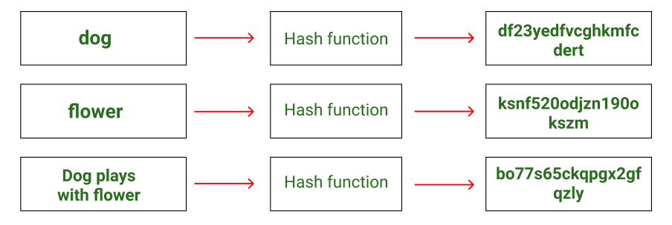
From the above picture, it is clear that even the slightest change in an alphabet in the input sentence can drastically change the hash obtained. Therefore hashes can be used to verify integrity.
What is Hash Pointer?
A regular pointer stores the memory address of data. With this pointer, the data can be accessed easily. On the other hand, a hash pointer is a pointer to where data is stored and with the pointer, the cryptographic hash of the data is also stored.
So a hash pointer points to the data and also allows us to verify the data. A hash pointer can be used to build all kinds of data structures such as blockchain and Merkle tree.

Slide 11
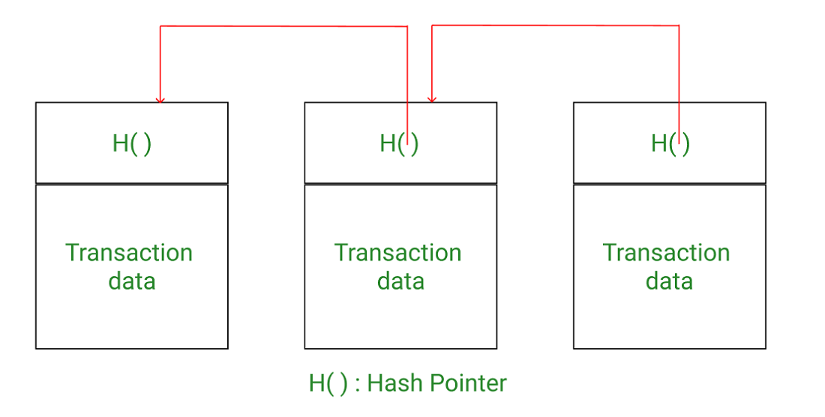
Merkle tree
A Merkle tree is a binary tree formed by hash pointers, and named after its creator, Ralph Merkle.
Blockchain as linked list with hash pointers

Slide 12
As mentioned earlier, each block is supposed to hold a certain number of transactions. To store these transactions within a block one approach can be to form a hash pointer-based linked list of transactions and store this complete linked list in a block.
However, when we put this approach into perspective, it does not seem practical to store a huge list of hundreds of transactions as if there is a need to find whether a particular transaction belongs to a block then we will have to traverse the blocks one by one and within each block traverse the linked list of transactions.
This is a huge overhead and can reduce the efficiency of the blockchain. Now, this is where the Merkle tree comes into the picture.
Merkle tree is a per-block tree of all the transactions that are included in the block. It allows us to have a hash/digest of all transactions and provides proof of membership in a time-efficient manner.
So to recap, the blockchain is a hash-based linked list of blocks, where each block consists of a header and transactions. The transactions are arranged in a tree-like fashion, known as the Merkle tree.

Slide 13
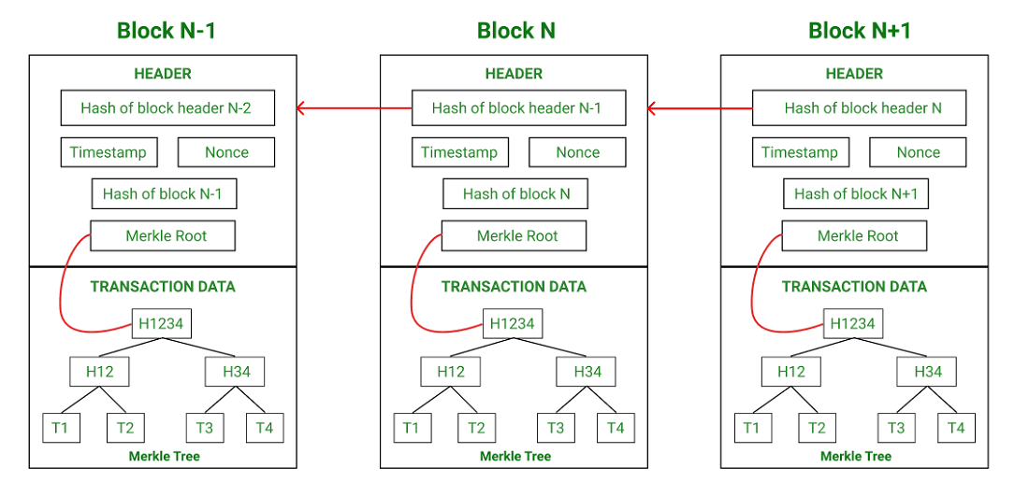
Each block comprises of block header + Merkle tree

Slide 14
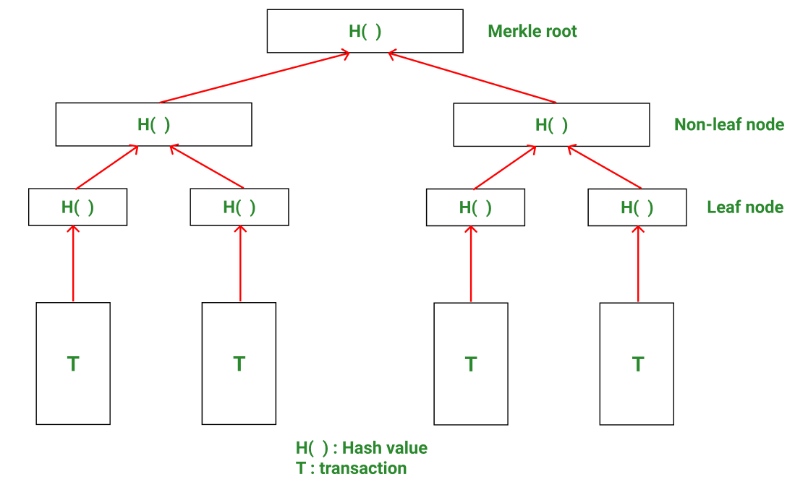
Structure of Merkle tree

Slide 15
1. A blockchain can potentially have thousands of blocks with thousands of transactions in each block. Therefore, memory space and computing power are two main challenges.
2. It would be optimal to use as little data as possible for verifying transactions, which can reduce CPU processing and provide better security, and this is exactly what Merkle trees offer.
3. In a Merkle tree, transactions are grouped into pairs. The hash is computed for each pair and this is stored in the parent node. Now the parent nodes are grouped into pairs and their hash is stored one level up in the tree. This continues till the root of the tree.

Slide 16
The different types of nodes in a Merkle tree are:
Root node: The root of the Merkle tree is known as the Merkle root and this Merkle root is stored in the header of the block.
Leaf node: The leaf nodes contain the hash values of transaction data. Each transaction in the block has its data hashed and then this hash value (also known as transaction ID) is stored in leaf nodes.
Non-leaf node: The non-leaf nodes contain the hash value of their respective children. These are also called intermediate nodes because they contain the intermediate hash values and the hash process continues till the root of the tree.
4. Bitcoin uses the SHA-256 hash function to hash transaction data continuously till the Merkle root is obtained.
5. Further, a Merkle tree is binary in nature. This means that the number of leaf nodes needs to be even for the Merkle tree to be constructed properly. In case there is an odd number of leaf nodes, the tree duplicates the last hash and makes the number of leaf nodes even.

Slide 17
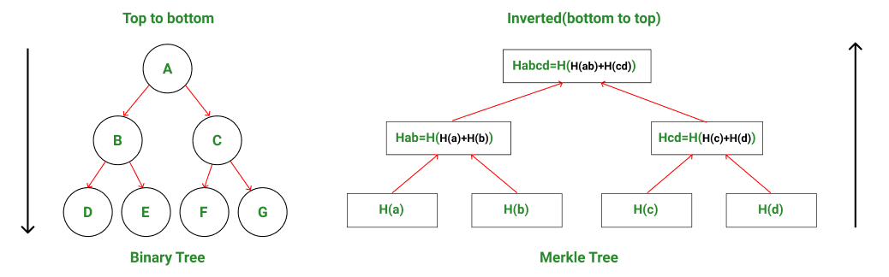
How Do Merkle Trees Work?
A Merkle tree is constructed from the leaf nodes level all the way up to the Merkle root level by grouping nodes in pairs and calculating the hash of each pair of nodes in that particular level.
This hash value is propagated to the next level. This is a bottom-to-up type of construction where the hash values are flowing from down to up direction.
Hence, by comparing the Merkle tree structure to a regular binary tree data structure, one can observe that Merkle trees are actually inverted down.

Slide 18
Example: Consider a block having 4 transactions- T1, T2, T3, T4. These four transactions have to be stored in the Merkle tree and this is done by the following steps-
Step 1: The hash of each transaction is computed.
H1 = Hash(T1)
Step 2: The hashes computed are stored in leaf nodes of the Merkle tree.
Step 3: Now non-leaf nodes will be formed.
In order to form these nodes, leaf nodes will be paired together from left to right, and the hash of these pairs will be calculated.
Firstly hash of H1 and H2 will be computed to form H12. Similarly, H34 is computed. Values H12 and H34 are parent nodes of H1, H2, and H3, H4 respectively. These are non-leaf nodes.
H12 = Hash(H1 + H2)
H34 = Hash(H3 + H4)

Slide 19
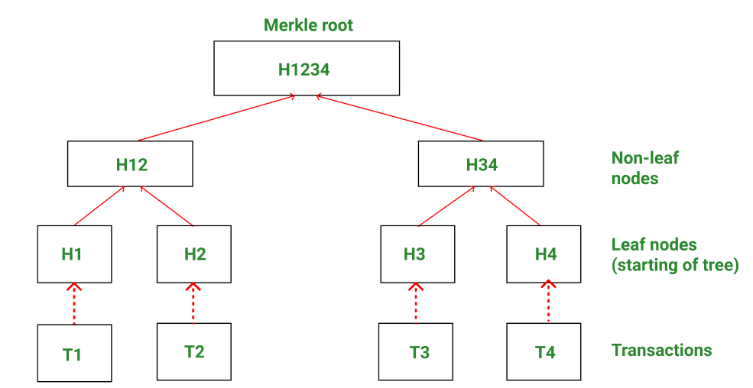
Step 4: Finally H1234 is computed by pairing H12 and H34. H1234 is the only hash remaining. This means we have reached the root node and therefore H1234 is the Merkle root.
H1234 = Hash(H12 + H34)
Merkle tree works by hashing child nodes again and again till only one hash remains.

Slide 20
Hardness of Bitcoin Mining
In order to ensure bitcoin blocks are discovered roughly every 10 minutes, an automatic system is in place that adjusts the difficulty depending on how many miners are competing to discover blocks at any given time.
As the name implies, bitcoin mining difficulty refers to the degree of difficulty involved in discovering new bitcoin blocks through mining.
Because the Bitcoin network is completely decentralized and not run by any single overarching authority, an algorithm hard-coded into the source code by Bitcoin’s creator(s) Satoshi Nakamoto is used.
This algorithm constantly readjusts the difficulty of the mining process in line with how many miners are operating in the network to ensure that blocks are discovered at a steady pace.

Slide 21
How Is Blockchain Verifiable By Public And Yet Anonymous?
One of the key characteristics of cryptocurrencies is that it allows the users to perform anonymous transactions.
Anonymity is imperative– When we talk about cryptocurrency transactions then maintaining the confidentiality becomes imperative. This is to ensure the security of transactions which is otherwise not possible in the current system of fund transactions.
Confidentiality- Most of the platforms involve system and method which facilitate the computation which is publically defined but maintains the privacy of the input data.
It is important to understand that anonymity is an important feature of the crypto word. However, with this feature, few queries arise. It is true that anonymity of transaction will also bring in many illegal transactions as it becomes difficult to know about the sender. This is primarily because of the continuously changing address of the sender’s wallet.

Slide 22
How is blockchain verifiable yet anonymous?
Blockchain ledger is public and maintaining anonymity is a daunting task. Thus, pseudo-anonymousn are used. By pseudo-anonymity, a person will be linked to a public Bitcoin address, but no one will get to know the actual name or address. To explain this in simple words, suppose a person sends a sum of money, then the receiver will get to know that the sender is linked to a bitcoin address but will not know the actual address. Hence, bitcoin or any other alt currencies are not entirely anonymous. There are various reasons for keeping everything hidden, the primary ones include :
Company-specific information
Law-enforcement related issues
Maintaining privacy
To explain this in simple words, it can be said that blockchain info in its system keeps on chaining the address for a given wallet. This discourages the ability to trace payments done to a particular wallet. Some of the other platforms like Private Instant Verified Transaction (PIVX) makes use of the mixing mechanism to attain anonymity.

Slide 23
Blockchain Forks
The decentralized nature of public blockchains (for example, Bitcoin and Ethereum) means that participants on the network must be able to come to an agreement as to the shared state of the blockchain(shared public ledger and blocks and the blockchain protocol). Unanimous consensus amongst the network nodes results in a single blockchain that contains verified data(transactions) that the network asserts to be correct.
However, many times, the nodes in the network can’t come in a unanimous consensus regarding the future state of the blockchain. This event leads to forks (like a tuning fork used in experimental science), meaning that point in which the ideal ‘single’ chain of blocks is split into two or more chains which are all valid.

Slide 24
FORKS IN BLOCKCHAIN:
In simple terms, Forks in blockchain means copying the code and modifying it to create a new software or product. In open-source projects Forks are very common and used widely. So, cryptocurrencies like Ethereum and Bitcoin are decentralized and open software so that anyone can contribute. As they are open-sources they rely on their communities to make the software more secure and reliable. Also open source with the help of fork can make user interface more interactive and look good, helping in gaining more users worldwide. In open source the code is visible to everyone, anyone can modify, edit, access there is no copyright claims for such actions.

Slide 25
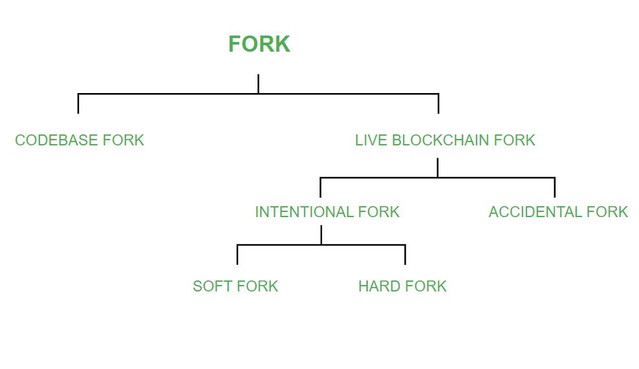
Different types of FORKS

Slide 26
Double Spending
Understanding Double Spending
Although Blockchain is secured, still it has some loopholes. Hackers or malicious users take advantage of these loopholes to perform their activities.
Double spending means the expenditure of the same digital currency twice or more to avail the multiple services. It is a technical flaw that allows users to duplicate money.
Since digital currencies are nothing but files, a malicious user can create multiple copies of the same currency file and can use it in multiple places.
This issue can also occur if there is an alteration in the network or copies of the currency are only used and not the original one.
There are also double spends that allow hackers to reverse transactions so that transaction happens two times.
By doing this, the user loses money two times one for the fake block created by the hacker and for the original block as well.
The hacker gets incentives as well for the fake blocks that have been mined and confirmed.

Slide 27
Double Spending
How Does Double Spending Happen?
Double spending can never arise physically. It can happen in online transactions. This mostly occurs when there is no authority to verify the transaction. It can also happen if the user’s wallet is not secured.
Suppose a user wants to avail of services from Merchant ‘A’ and Merchant ‘B’.
The user first made a digital transaction with Merchant ‘A’.
The copy of the cryptocurrency is stored on the user’s computer.
So the user uses the same cryptocurrency to pay Merchant ‘B’
Now both the merchants have the illusion that the money has been credited since the transactions were not confirmed by the miners.
This is the case of double spending.

Slide 28
Types Of Double Spending Attacks
There are different types of Double Spending attacks:
Finney Attack: Finney Attack is a type of Double spending Attack. In this, a merchant accepts an unauthorized transaction. The original block is eclipsed by the hacker using an eclipse attack. The transaction is performed on an unauthorized one. After that, the real block shows up and again the transaction is done automatically for the real block. Thus the merchant loses money two times.
Race attack: is an attack in which there is a ‘race’ between two transactions. The attacker sends the same money using different machines to two different merchants. The merchants send their goods but transactions get invalid.
51% Attack: This type of attack is prevalent in small blockchains. Hackers usually take over 51% of the mining power of blockchain and therefore can do anything of their own will.

Slide 29
How Bitcoin Handles Double Spending?
Bitcoin is one of the most popular blockchains. To combat Double spending it uses some security measures. There are two types of examples of double spending in BTC.
The first case is making duplicates of the same bitcoin and sending it to multiple users.
The second case is performing the transaction and reversing the already sent transaction after getting the service.
To tackle these double-spending issues, some security measures are taken. They are:
Validation: Validation of transactions by a maximum number of nodes in the network. Once a block is created, it is added to a list of pending transactions. Users send validation for the block. If the verifications are done then only the block is added to the blockchain.

Slide 30
Timestamp: The confirmed transactions are timestamped, therefore they are irreversible. If a transaction is involved with a bitcoin it is verified and done. But in the future, if other transactions are made with the same bitcoin, the transactions will be canceled.
Block Confirmations: Merchants get block confirmations so that they are assured that there was no case of double spending. In bitcoin, a minimum of 6 confirmations are done.
Saving copies: A copy of each transaction is kept at each node so in case of network failure the whole network does not go down.
These security features have reduced double spending to a large extent.

Slide 31
Bitcoin Blockchain Challenges
Lack of adoption
Blockchains function more effectively and efficiently when used across a wide network of users. A blockchain ecosystem, for example, would not only need users to join the network but also its suppliers.
The rising cost of blockchain implementation
It’s all about early financial outlays. For some companies, implementation expenditures may be prohibitive. Even if most current solutions are free, a significant investment is required when hiring skilled software engineers who specialize in blockchain development, licensing fees in case of switching to a chargeable software version, overall administration, and more. It is one of the most important blockchain implementation challenges.
Scalability
The main difficulty with its implementation is scalability. Though transaction networks can handle hundreds of transactions per second without failure, when it comes to Bitcoin (roughly 3-7 transactions per second) and Ethereum (about 15-20 transactions), processing the transactions slows down considerably, making blockchain unviable for large-scale apps.

Slide 32
Bitcoin Blockchain Challenges
Security and privacy challenges
What are some of the most pressing questions you should consider? What about the numerous security and privacy concerns? While cryptocurrencies provide pseudonymity, many potential blockchain applications need smart transactions and contracts to be indisputably linked to real identities, raising significant privacy and data security issues.
Regulations
The lack of regulation will be the next area where you may face difficulties. Scams and market manipulation that might trigger a global economic collapse are not out of the question. As a result, Bitcoin has been getting lots of negative attention from all around the world.
Criminal activities
The absence of stringent legislation and the fact that blockchain is still a developing technology have fueled the rise of fraudulent projects and other bad actors seeking to profit from inexperienced investors.

Slide 33
Bitcoin Blockchain Challenges
Energy consumption
Another worry is that Proof of Work, the most widely used consensus algorithm, is energy-intensive. This restricts entry for regular people into PoW networks, encourages the formation of big mining pools, and prevents decentralization by pushing individuals to join large mining pools, and it also raises environmental concerns.
51% attacks
The architecture of blockchain technologies is distinct. Some are more secure than others. The decentralized blockchains, for example, are more vulnerable to 51% attacks than the centralized ones. This has introduced a few issues for crypto investors who want to store their assets on decentralized chains.
51% attacks, in which hackers acquire more than half of the network’s computational power, are an issue that has plagued many blockchain systems.
Low workforce availability
Over the last year, the nonfungible token (NFT) and DeFi industries have seen a tremendous rise in nonfungible tokens and projects, leading to labor market issues. According to recent data, demand for blockchain talent has increased by over 300% among both established businesses and startups as they look for top-tier personnel.

Slide 34
Bitcoin Blockchain Challenges
Energy consumption
Another worry is that Proof of Work, the most widely used consensus algorithm, is energy-intensive. This restricts entry for regular people into PoW networks, encourages the formation of big mining pools, and prevents decentralization by pushing individuals to join large mining pools, and it also raises environmental concerns.
51% attacks
The architecture of blockchain technologies is distinct. Some are more secure than others. The decentralized blockchains, for example, are more vulnerable to 51% attacks than the centralized ones. This has introduced a few issues for crypto investors who want to store their assets on decentralized chains.
51% attacks, in which hackers acquire more than half of the network’s computational power, are an issue that has plagued many blockchain systems.
Low workforce availability
Over the last year, the nonfungible token (NFT) and DeFi industries have seen a tremendous rise in nonfungible tokens and projects, leading to labor market issues. According to recent data, demand for blockchain talent has increased by over 300% among both established businesses and startups as they look for top-tier personnel.

Slide 35
Proof of Work (PoW)
Proof of Work consensus is the mechanism of choice for the majority of cryptocurrencies currently in circulation. The algorithm is used to verify the transaction and create a new block in the blockchain.
Proof of Work(PoW) is the original consensus algorithm in a blockchain network. The algorithm is used to confirm the transaction and creates a new block to the chain. In this algorithm, minors (a group of people) compete against each other to complete the transaction on the network.
The process of competing against each other is called mining. As soon as miners successfully created a valid block, he gets rewarded. The most famous application of Proof of Work(PoW) is Bitcoin.

Slide 36
Proof of Work (PoW)
Producing proof of work can be a random process with low probability. In this, a lot of trial and error is required before a valid proof of work is generated.
The main working principle of proof of work is a mathematical puzzle which can easily prove the solution. Proof of work can be implemented in a blockchain by the Hashcash proof of work system.
In the below image, you can see that this block is composed of a block number, data field, cryptographic hash associated with it and a nonce. The nonce is responsible for making the block valid.

Slide 37
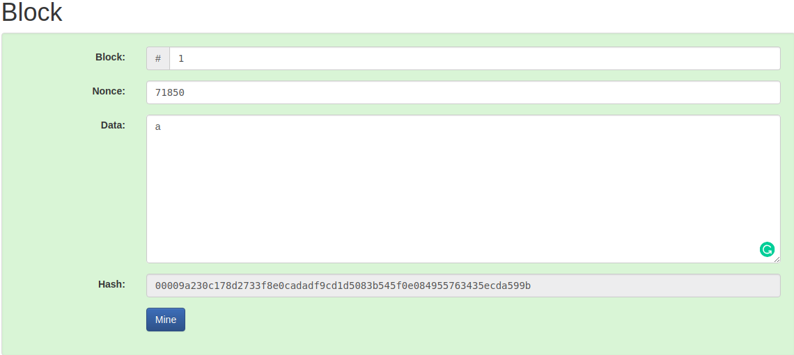
In the puzzle game, bitcoin software creates a challenge, and there is a game begins. This game involves all miners competing against each other to solve the challenges, and this challenge will take approximately 10 minutes to be completed.

Slide 38
Every single miner starts trying to find the solution to that one Nonce that will satisfy the hash for the block. At some specific point, one of those miners in the global community with higher speed and great hardware specs will solve the cryptography challenge and be the winner of the game.
Now, the rest of the community will start verifying that block which is mined by the winner. If the nonce is correct, it will end up with the new block that will be added to the blockchain. The concept of generating a block provides a clear explanation of proof of work(PoW).

Slide 39
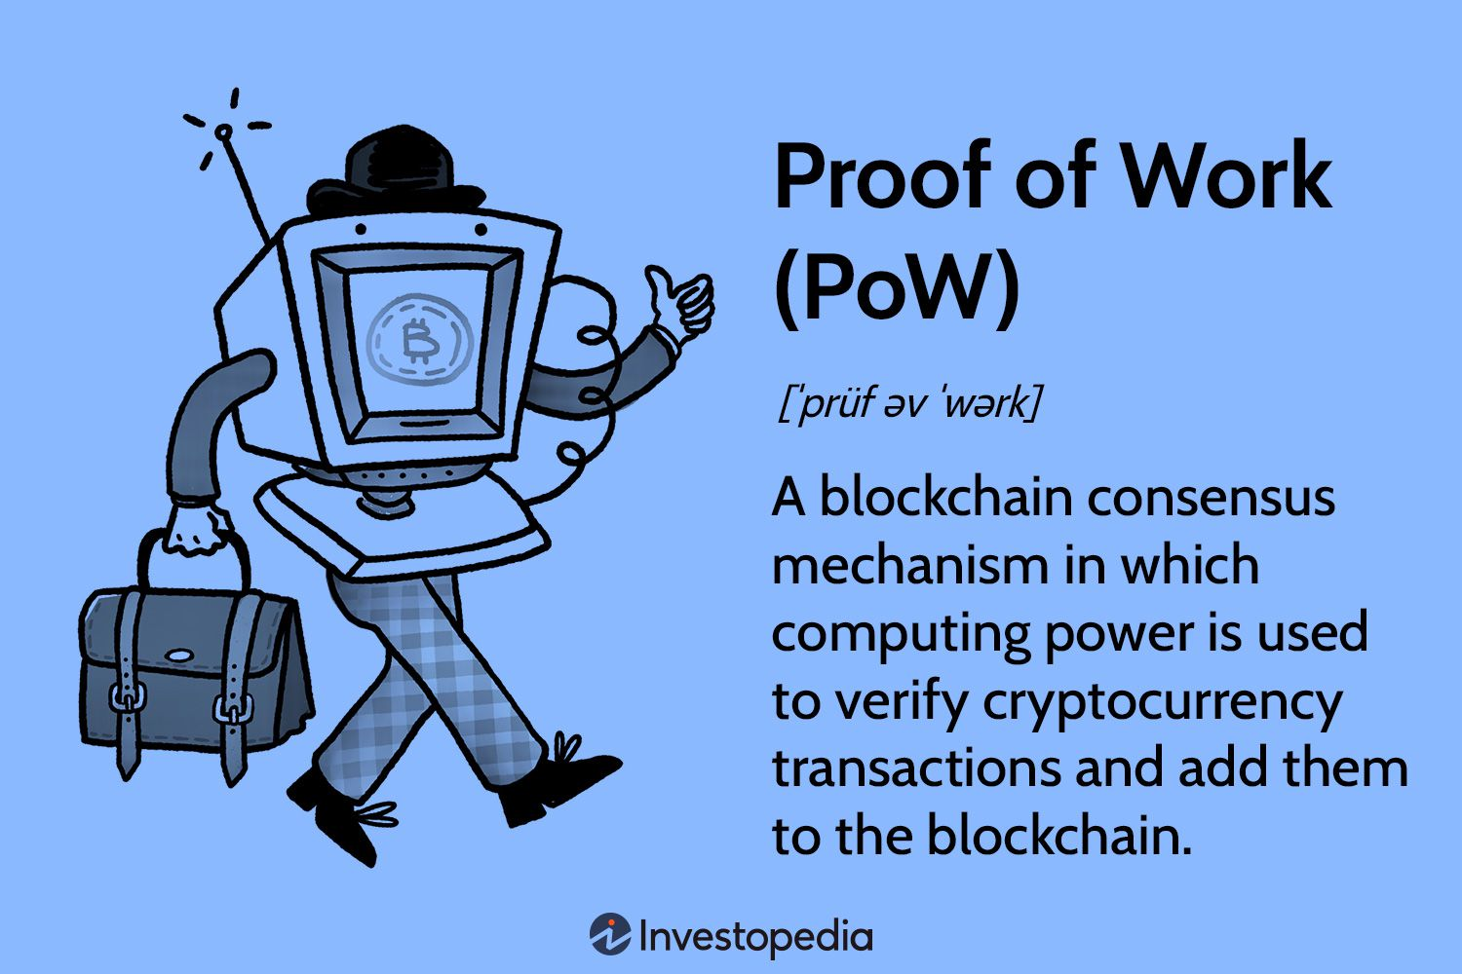

Slide 40
Proof of Stake (PoS)
Proof of Stake (PoS) is a type of algorithm which aims to achieve distributed consensus in a Blockchain.
A stake is value/money we bet on a certain outcome. The process is called staking.
Why Proof-of-Stake: Before proof of stake, the most popular way to achieve distributed consensus was through Proof-of-Work (implemented in Bitcoin). But Proof-of-Work is quite energy intensive. So, a proof-of-work based consensus mechanism increases an entity’s chances of mining a new block if it has more computation resources.
Apart from the upper two points, there are other weaknesses of a PoW based consensus mechanism which we will discuss later on. In such a scenario, a Proof-of-Stake based mechanism holds merit.

Slide 41
What is Proof-of-Stake:
As understandable from the name, nodes on a network stake an amount of cryptocurrency to become candidates to validate the new block and earn the fee from it.
Then, an algorithm chooses from the pool of candidates the node which will validate the new block. This selection algorithm combines the quantity of stake (amount of cryptocurrency) with other factors to make the selection fair to everyone on the network.

Slide 42
A typical PoS based mechanism workflow:
Nodes make transactions. The PoS algorithm puts all these transactions in a pool.
All the nodes contending to become validator for the next block raise a stake. This stake is combined with other factors like ‘coin-age’ or ‘randomized block selection’ to select the validator.
The validator verifies all the transactions and publishes the block. His stake still remains locked and the forging reward is also not granted yet. This is so that the nodes on the network can ‘OK’ the new block.
If the block is ‘OK’-ed, the validator gets the stake back and the reward too. If the algorithm is using a coin-age based mechanism to select validators, the validator for the current block’s has its coin-age reset to 0. This puts him in a low-priority for the next validator election.
If the block is not verified by other nodes on the network, the validator loses its stake and is marked as ‘bad’ by the algorithm. The process again starts from step 1 to forge the new block.

Slide 43
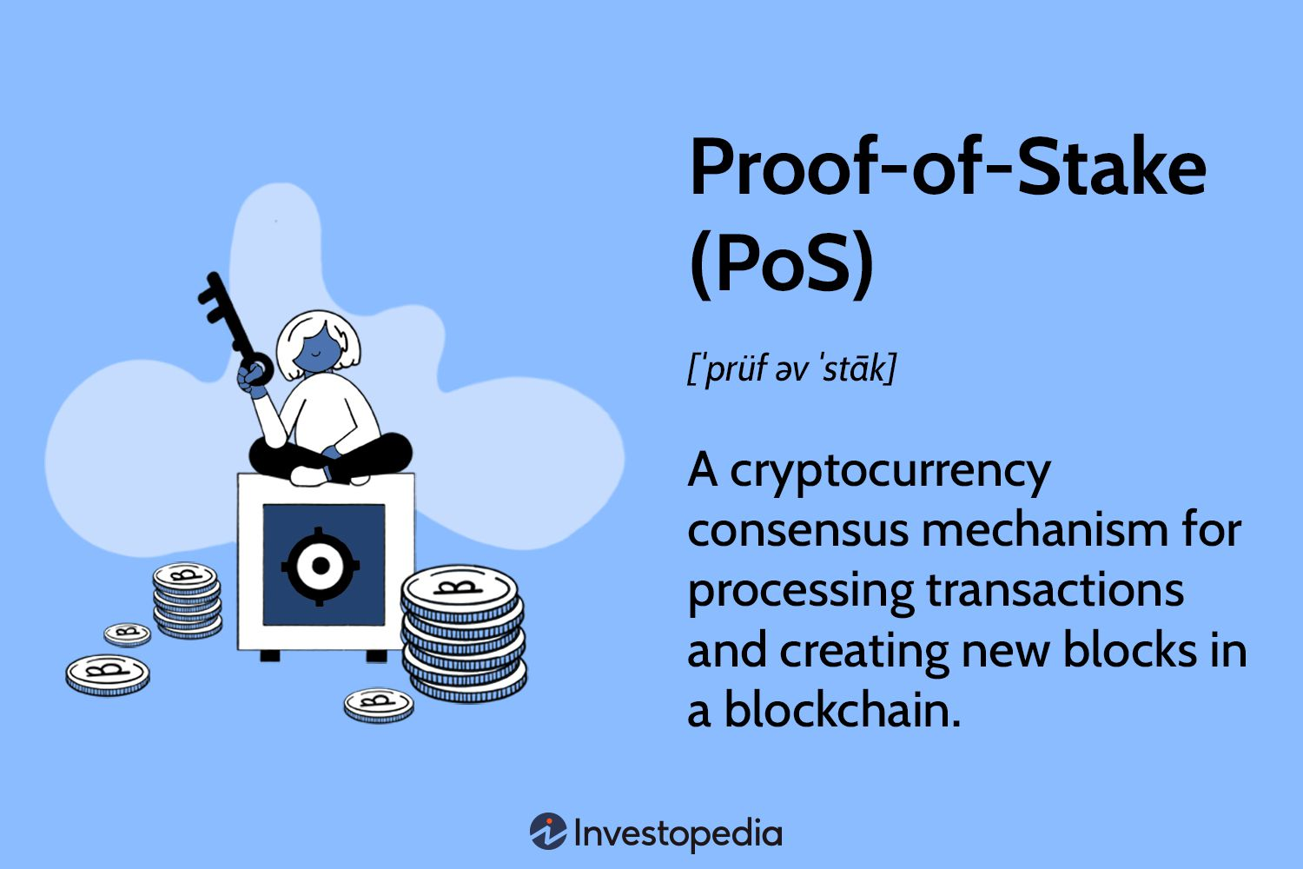

Slide 44
Alternative Blockchain Consensus Mechanisms
Mechanisms other than proof of work and proof of stake
A blockchain consensus mechanism is the protocol used to agree on the “truth” when the blockchain is receiving data from many independent nodes that may be faulty or otherwise untruthful.
The two most common consensus mechanisms are proof of work and proof of stake.
1. Proof of burn: Proof of burn is somewhat similar to proof of stake in the sense that they both use a system based on monetary cost to achieve consensus.
However, while proof of stake only results in losses for bad actors in the network, proof of burn requires all participants, truthful or not, to sacrifice tokens.
In order to mine a block, the miner must send tokens to a “burner” address that cannot send tokens — these tokens are thus “burned” in the sense that they are no longer in circulation and are inaccessible.
Generally, the more coins that a user burns, the more likely they are to mine the next block.

Slide 45
Proof of capacity: It is similar to proof of work, but uses storage instead of computation.
Proof of elapsed time: In proof of elapsed time, you are given a random amount of time to wait, and the first person to be done waiting gets to determine the next block. The lottery-like selection is accomplished using
Intel SGX, which allows applications to run trusted code in a protected environment; this ensures that the wait times are created fairly and that the participants actually wait the required amount of time.
Trusted code can be verified using specialized hardware and is separated from the rest of the application, so it can be proved that a network participant is running the correct code.

